Slide 1

Final project- prime selection
Presenters: Ofir Gurvits, Ariel Elbaz , Ofek Binder
Instructed by: Eylon Yogev

Slide 2
Table of Contents
Main Idea
Zero-knowledge , and SNARKs.
Technologies and framework.
Use cases.

Slide 3
Main idea
In cryptography there are many settings in which we use prime numbers.
Those prime numbers need to be agreed upon.
We don’t want the client to compute the prime number.
We don’t want the server to have full control on the choice of the prime number.

Slide 4

The protocol
The client samples a random number $x∈ℱ .$
The server knows $x$ and the client and server agree on some hash function $h.$
Now the server wants to do the complex computation and check if $h\left(x+a\right)$is a prime number using Miller-Rabin algorithm.
We want to return the smallest $a$ such that $h(x+a)$ is prime number.
Ideally, we want $a=0$such that $h(x)$ is prime number But $h\left(x\right)$is not necessarily a prime number.
So, we will calculate $h\left(x\right),h\left(x+1\right),h\left(x+2\right),…..,h\left(x+a−1\right),h(x+a$).

Slide 5

Cont.
The server wants to provide a succinct proof to the client such that:
$h\left(x\right),h\left(x+1\right),h\left(x+2\right),…..,h\left(x+a−1\right)$ are not prime numbers
$h\left(x+a\right)$ is prime number.
The client wants to verify this proof in a short time and will be convinced that:
$h\left(x\right),h\left(x+1\right),h\left(x+2\right),…..,h\left(x+a−1\right)$ are not prime numbers
$h\left(x+a\right)$ is prime number.
By the Prime Number theorem we get that It wont take long for the prover to find a prime number.

Slide 6
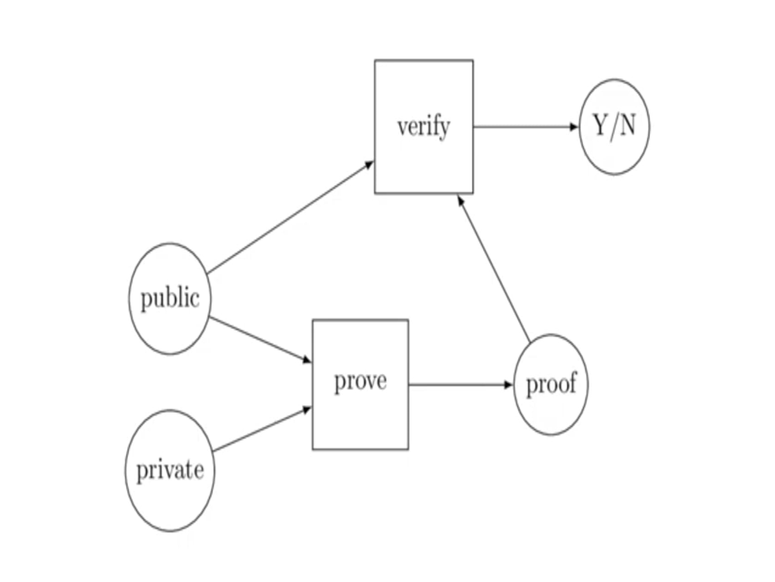
What is zkSNARKS
zkSNARKs are cryptographic proofs that allow one party (the prover) to convince another party (the verifier) that they possess certain information without revealing the information itself.
Importance: Ensures privacy and security in various applications like blockchain, finance, and data verification.

Slide 7
Arkworks-rs
arkworks is a Rust ecosystem for zkSNARK programming.
Libraries in the arkworks ecosystem provide efficient implementations of all components required to implement zkSNARK applications, from generic finite fields to R1CS constraints for common functionalities.
R1CS is a NP-complete language that will help us represent our calculation.

Slide 8
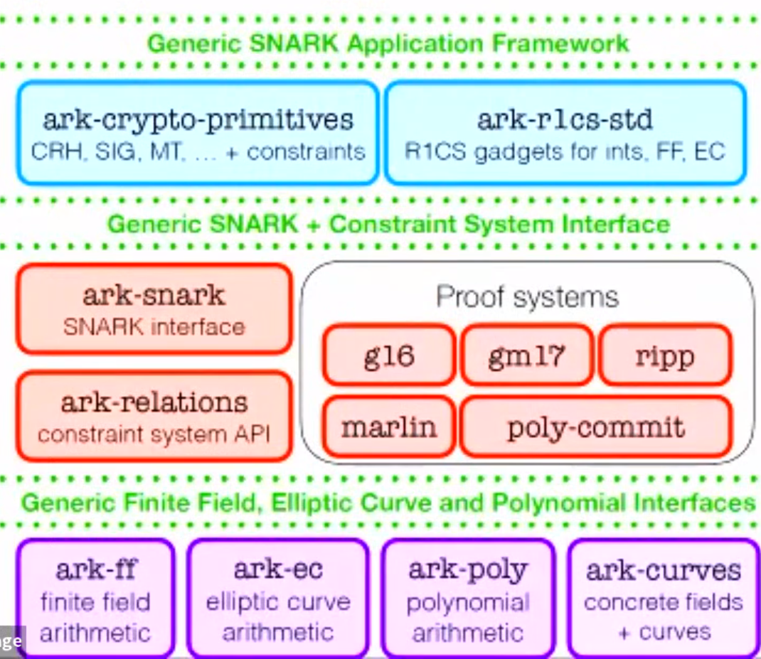

Slide 9
Our Snark for Fibonacci:
The user enters starting values a,b and number of steps - n
Prover calculates and generates proof for the n-th fibbonaci number based on a,b.
Verifier checks that the prover doesn’t lie.
The size of the proof in bytes, Verification time, Proving time, Total time taken.
Link for Github: https://github.com/ArielElb/zkSNARk-fibbonaci

Slide 10
Use cases
1. Cryptographic Key Generation:
- Use Case: Generating secure cryptographic keys.
- Explanation: The client and server could jointly derive a prime number from a random seed 𝑥 using the described protocol. The resulting prime number could then be used as a key in cryptographic applications.
2. Token Generation in Blockchain:
- Use Case: Creating unique tokens in a blockchain.
- Explanation: The protocol could be employed to collaboratively generate unique token values based on the random seed 𝑥. These tokens could be used in blockchain transactions or smart contracts, ensuring a secure and decentralized method for token creation.

Slide 11
Cont.
3. Random Number Generation for Gaming:
- Use Case: Fair and secure random number generation for online gaming.
- Explanation: In gaming applications, the protocol could be used to collaboratively generate a random number for various purposes, such as determining game outcomes or distributing resources. The prime number property ensures unpredictability and fairness.
4. Secure Parameter Generation in Multi-Party Computation:
- Use Case: Secure multi-party computation.
- Explanation: The protocol can be utilized to generate secure parameters in multi-party computation scenarios. Each party can contribute to the determination of 𝑎, ensuring that the resulting value is not known by any single entity until the collaborative process is complete.

